Slide 1
Semi Supervised Multi-View Correlation Feature Learning with Application to Webpage Classification
Team - 3 (Abnormal Distribution)
Shobhan Mandal(20172064)
Arijit Mukherjee(20172081)
Ranajit Saha(20172119)
Sanjoy Chowdhury(20172123)

Slide 2
Semi Supervised Learning:
Simple Terms: A class of supervised learning tasks and techniques that make use of unlabelled data for training - typically a small amount of labelled data with large amount of unlabelled data. (It lies in between the un-supervised learning and supervised learning).
Here, Labeled data is used to help identify that there are specific groups of webpage types present in the data-set and what they might be. The algorithm is then trained on unlabeled data to define the boundaries of those web page types and may even identify new types of web-pages that were unspecified in the existing human inputted labels.

Slide 3
Multi-view Learning :
Many real-world datasets possess data samples characterized using multiple views,e.g., web-pages can be described using both textual content in each page and the hyperlink structure between them.
It has been shown that the error rate on unseen test samples can be upper bounded by the disagreement between the classification decisions obtained from independent views of the data.
This relatively new machine learning technique, commonly called as Multiview Learning has been predominantly successfully used in conjunction with semi-supervised and also unsupervised approaches.
Each example is described using two different feature sets that provide different, complementary information about the instance.
Ideally, the two views are conditionally independent (i.e., the two feature sets of each instance are conditionally independent given the class) and each view is sufficient (i.e., the class of an instance can be accurately predicted from each view alone).
Co-training first learns a separate classifier for each view using any labeled examples. The most confident predictions of each classifier on the unlabeled data are then used to iteratively construct additional labeled training data.
Notes:
In probability theory, two events R and B are conditionally independent given a third event Y precisely if the occurrence of R and the occurrence of B are independent events in their conditional probability distribution given Y. In other words, R and B are conditionally independent given Y if and only if, given knowledge that Y occurs, knowledge of whether R occurs provides no information on the likelihood of B occurring, and knowledge of whether B occurs provides no information on the likelihood of R occurring.

Slide 4
Introduction
Webpage classification refers to the problem of assigning a webpage class that describes its contents. A webpage classification has 3 characteristics :
Webpage is a kind of multi-view data, since it usually contains two or more types of data, e.g., text, hyperlinks and images, where each type of data can be regarded as a view.
Webpage classification is a semi-supervised application, since labeled pages are harder to collect compared to unlabeled pages in practice.
Webpage data is high-dimensional, since webpages usually contain much information. Considering these three characteristics, it is crucial to design effective semi-supervised multi-view feature learning (SMFL) methods for webpage classification.
These 3 characteristics have been taken into account by two other webpage classification methods only :-
SSGCA
USI²MD
Notes:
SSGCA : Semi Paired and Semi Supervised Generalized Correlation Analysis ; USI2MD : Uncorelated semi-supervised intra-view and inter-view manifold discrimination. The big difference is USI²MD does not consider the correlation among multiple views and SSGCA does not explore the intra-view correlation information, while our SMCFL can effectively utilize the intra-view and inter-view discriminant correlation information.

Slide 5
What this paper is about...
Webpage classification application is usually semi-supervised and currently using Semi-supervised Multi-view Feature Learning (SMFL) technique to deal with the webpage classification problem is on the rise.
Effectively utilize the correlation information among multi-view of webpage data is an important research topic. Correlation analysis on multi-view data can facilitate extraction of the complementary information.
This paper proposes a novel SMFL approach Semi-supervised Multi-view Correlation Feature Learning (SMCFL), for web-page classification.
SMCFL seeks for a discriminant common space by learning a multi-view shared transformation in a semi-supervised manner.
In the discriminant space, the correlation between intra-class samples is maximized, and the correlation between inter-class samples and the global correlation among both labeled and unlabeled samples are minimized simultaneously.
Notes:
Web page classification has attracted lot of research interest. - The data in it is often multi-view and high-dimensional. (2) After - There exists room for improvement.

Slide 6
Motivation & Contribution
The correlation information from inter-view and intra-view depicts the association relationship among multiple views which has close connection with classification.
The “inter-view” and “intra-view” mean the relationship between samples across different views and within certain view, respectively.
The inter-view correlation contains the within-class and between-class correlation of samples across different views.
The intra-view correlation contains the within-class and between-class samples within the same view.
From WebKB dataset as an example, we randomly select 10 webpage samples of each class in the link and page views and perform the Principal Component Analysis (PCA) transformation to obtain two major components of each sample for plotting the sample distribution in the graph next page.

Slide 7
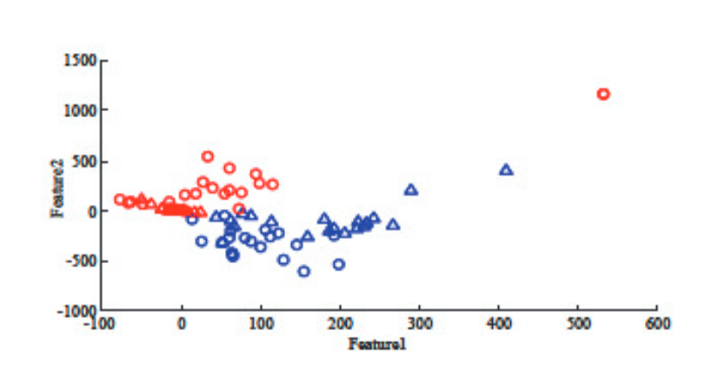
Motivation & Contribution (Contd.)
Sample Distribution of 40 webpage samples in the WebKB dataset, where RED and BLUE colors denote two views, and
CIRCLE( ) and TRIANGLE ( ) markers denote sample points from two classes.
Here we are finding that samples of different views own small correlation and between-class samples within each view own relatively large correlation.
Therefore we would be maximizing the correlation of samples from different views while in the same class and minimize the correlation of samples in the same view wule from different classes to make the distribution more favourable for classification.
Notes:
Ending Note : This proves that it is necessary to perform correlation analysis on webpage data which can help us to learn features with favourable separability.

Slide 8
Motivation & Contribution (Contd.)
The most noted drawbacks in the current SMFL methods are:-
Some of the Existing SMFL methods do not consider the correlation information
For other there exists much room to improve their discriminant abilities, since
They do not explore intra-view correlation information.
They simply maximizes the correlation from both intra-view and inter-view, which cannot make full use of the discriminant correlation from the aspect of classification.
They only maximizes the inter-view within-class correlation without considering the inter-view between-class correlation.

Slide 9
The summarization of the study:
The objective function of SMCFL is designed to maximize the correlation between intra-class samples, and minimize the correlation between inter-class samples and the global correlation among both labeled and unlabeled samples. SMCFL can thus effectively explore the intra-view and inter-view discriminant correlation information.
The solution is global optimal and can be derived analytically without iterative calculation. (The authors believe the proposed work is the first to present this kind of solution, which can be applied to other correlation-based feature learning problems.)
SMCFL is verified on a widely used webpage dataset (WebKB). The experimental results show that it can significantly outperform state-of-the-art webpage classification method.

Slide 10

Objective Function of SMCFL
Suppose that X_{l} = {X₁,X₂,...,X_{c}} is the labeled training webpage sample set from C classes, where each X_{i}(i=1,...,C) contains webpage samples of M views and x^{s}_{ip} R^{dx1} denotes the p^{th} webpage sample from the s^{th} view of the i^{th} class.
Here, d denotes the dimensionality of samples.
Assume that l^{s}_{i} denotes the number of samples from the s^{th} view and the i^{th} class, and l_{i} = denotes the number of samples in the i^{th} class. Let X^{M} be the unlabeled training sample set, X={X^{l},X^{M}}, and N denotes the total sample number in X. For simplicity of representation, we regard X^{M} as the (C+1)^{th} class.

Slide 11
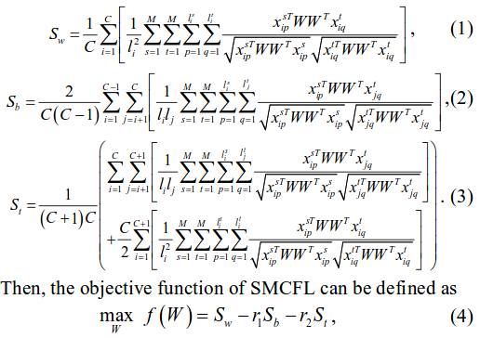
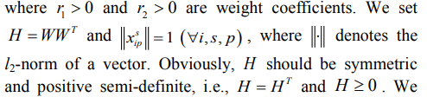

Slide 12

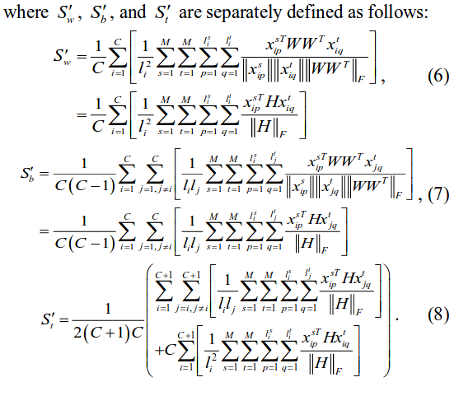
We set H = WW^{T} and ||x^{s}_{ip}|| = 1 , where ||.|| denotes the l₂-norm of a vector. Obviously, H should be symmetric, i.e., H = H^{T}
We relax (4) into the following formulation:

Slide 13
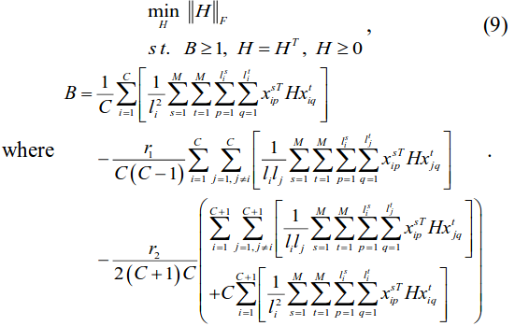
Similarly (5) can be further translated into:

Slide 14
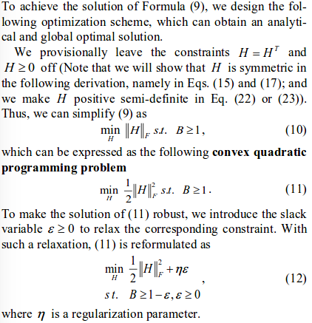
Solution of SMFCL

Slide 15
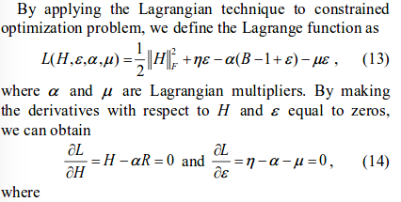
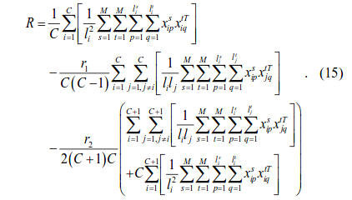

Slide 16
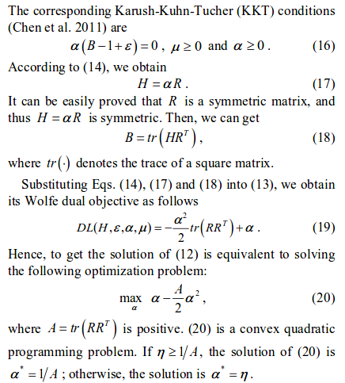

Slide 17
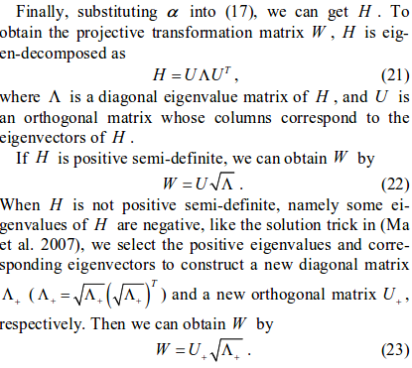
Notes:
WW’ = H
H = UAU’

Slide 18
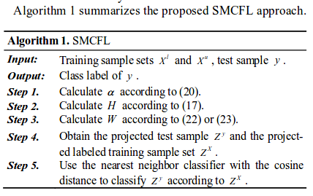
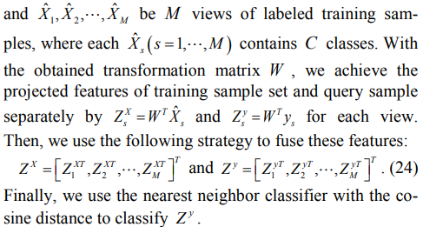
Solution of SMFCL (contd.) [Algorithm]

Slide 19
Data Preprocessing
Extracting text content from HTML page
Top ‘N’ Principal component extraction
Basic text processing
Train test splitting for K fold cross validation
Tf-Idf matrix formation
Dumping text files

Slide 20
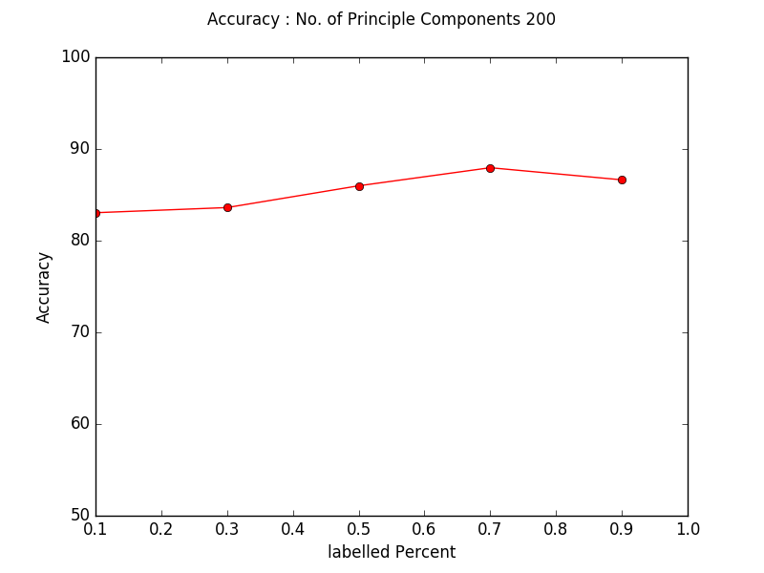
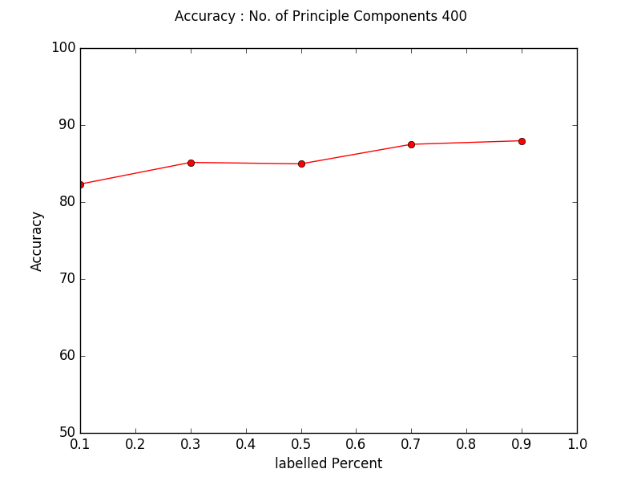
Experimental Results

Slide 21
Thank You !!!

